Slide 1



DIASPORTCAMP project
First Coordination call
18/11/2024

Slide 2
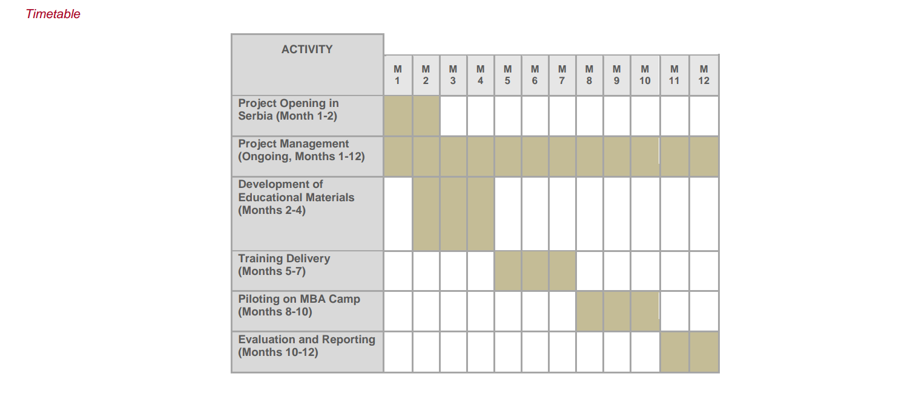
PARTNERS:
- MAMUT 2018
- HAŠK Mladost
- MP SPort

Slide 3
Next activites:
- Meeting in Kragujevac(Lead mamut 2018)
- Development of educational materials (hašk)
- Website /promo campaign dev (mamut 2018)

Slide 4
Your next actions:
- write all emails to sasaciric@live.com
- check dates for Kragujevac meeting
- contracts between applicant and partners

Slide 5
See you in kragujevac
- december 2024 - diasportcamp project

