Slide 1


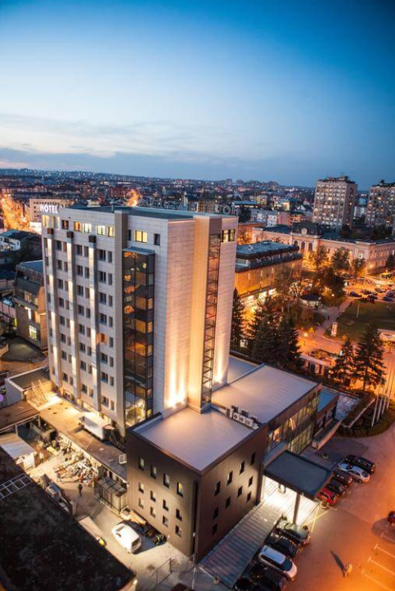

DIASPORTCAMP project
PROJECT OPENING
KRAGUJEVAC
08/01/2024 – 09/01/2025

Slide 2
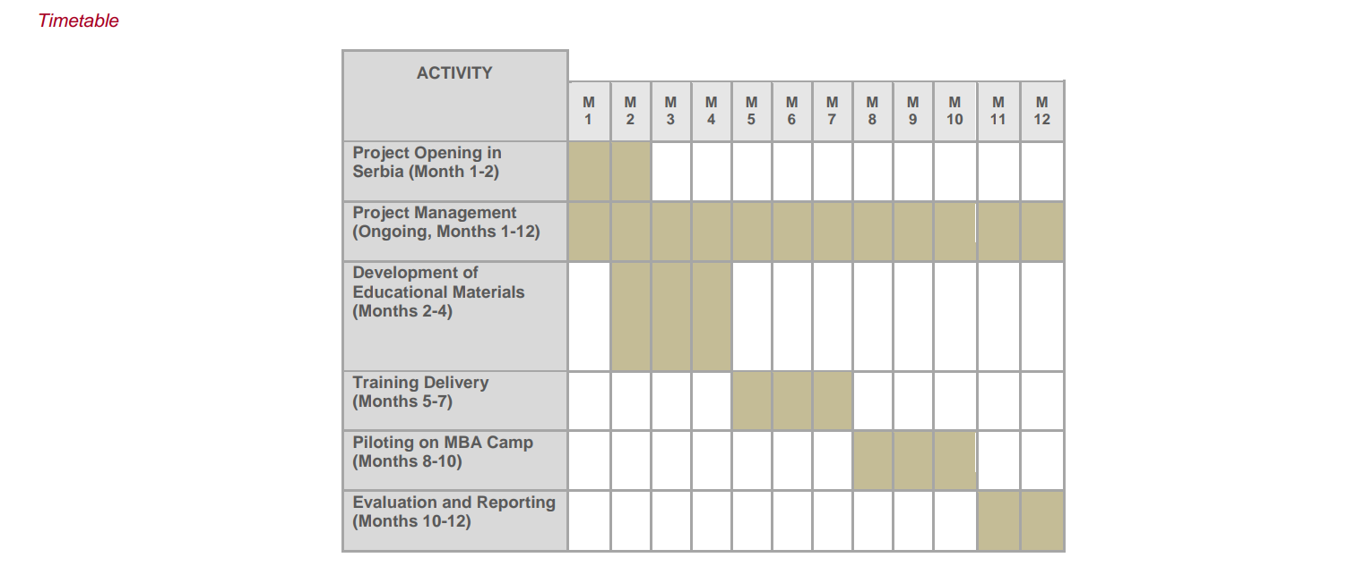
PARTNERS: - MAMUT 2018 - HAŠK Mladost - MP SPort

Slide 3
Next activites: - Meeting in Kragujevac(Lead mamut 2018) - Development of educational materials (hašk) - Website /promo campaign dev (mamut 2018)

Slide 4
our next actions: - Transfer tranche 1/experts for education - DISCUS PROJECT PHASE 2 - contracts between applicant and partners - Development of educational materials (hašk) - Website /promo campaign dev (mamut 2018)

Slide 5
Next coordination call - february 2025 - diasportcamp project

